Slide 1
Cardio Good Fitness Business Case - Analysis
SARAVANAN RANGARAJAN (SR)

Slide 2
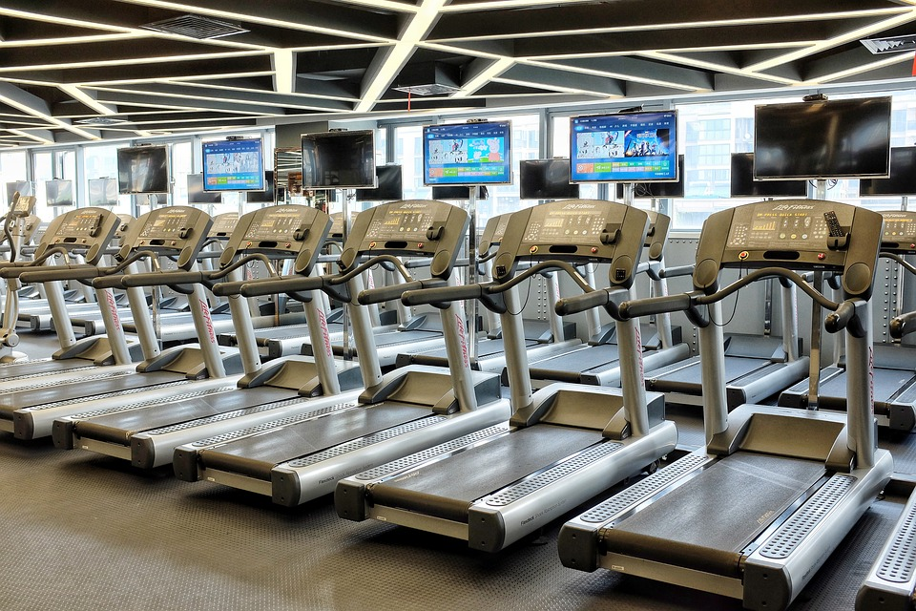
Contents
Business Problem Overview
Solution Approach
Data – Initial Look
Age – Income – Education Analysis
Deeper Look on Age & Income
Data Relationship
Correlation
Business Insights and Recommendations
Questions

Slide 3

Business Problem Overview
Cardio Good Fitness is exercise equipment's selling Retail Store looking to increase sales of its products by understanding potential Customer characteristics.
Three products TM195, TM498 & TM798 are currently sold in the market. Based on the current user base, Cardio Good Fitness collected the data to have focused customers to market and sell their products.
Understanding customer behavior by conducting Questionnaire based Survey is one of the proven approach, where in Sample of the targeted population would give perspective and marketing insights.
By Improving the Sales, the store revenue would increase thus bringing in more products to market.
This Photo by Unknown Author is licensed under CC BY-NC

Slide 4
Solution Approach
With the Dataset collected, Exploratory Data Analysis to be performed to find patterns and propose Business recommendations
Following are the set of activities to be performed
Understand the quality of data
Try to mark out the data collected is good for analysis by checking the skewness, categorical variable analysis.
Perform Univariate & Multivariate Analysis to find relation ship between various factors, so that patterns can be identified for efficient Business recommendations
Also, identify the any stale data collected, so the data collection process can be improved.
This Photo by Unknown Author is licensed under CC BY-NC

Slide 5

Data Overview
Data was collected across customers of Treadmill products. It contains following fields
Product - The model no. of the treadmill
Age - Age of the customer in no of years
Gender - Gender of the customer
Education - Education of the customer in no. of years
Marital Status - Marital status of the customer
Usage - Avg. # times the customer wants to use the treadmill every week
Fitness - Self rated fitness score of the customer (5 - very fit, 1 - very unfit)
Income - Income of the customer
Miles- Miles that a customer expects to run
It has 5 Numerical values & 4 Categorical values ( Marital Status, Gender, Product & Fitness)
Null checks have been done to check the data. No null values exist.
Duplicate checks have been done. No Duplicate values exist.
Check the distinct values in the Categorical columns and check the data spread for general information.
This Photo by Unknown Author is licensed under CC BY-NC

Slide 6
Age – Income – Education Analysis
Average age group & Income & Education for all 3 products are shown below
We can see that Average age is 29 and Income level for TM195 & TM498 is almost same and same with Education Level
Obviously TM798 has income level higher denoting that it is the most expensive among 3.
Products | Age | Income | Education
TM195 | 28.55 | 46418.0 | 15.03
TM498 | 28.9 | 48973.7 | 15.11
TM798 | 29.1 | 75441.6 | 17.32
This Photo by Unknown Author is licensed under CC BY-NC

Slide 7
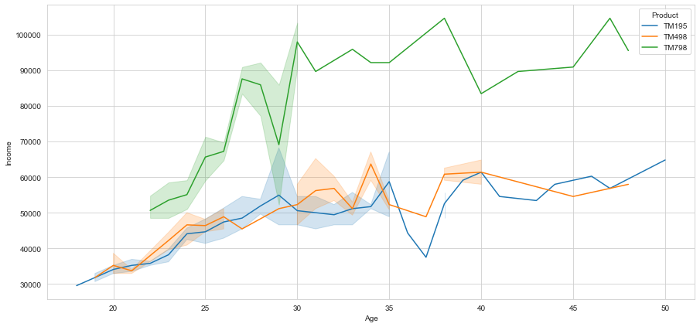
Deeper Look on Age & Income
From the above chart it is very obvious that products TM195 & TM498 is popular among same segment of customers across Income & Age, that leads that one product is redundant. Either can be retired or enhanced for the segment above.
This Photo by Unknown Author is licensed under CC BY-NC

Slide 8
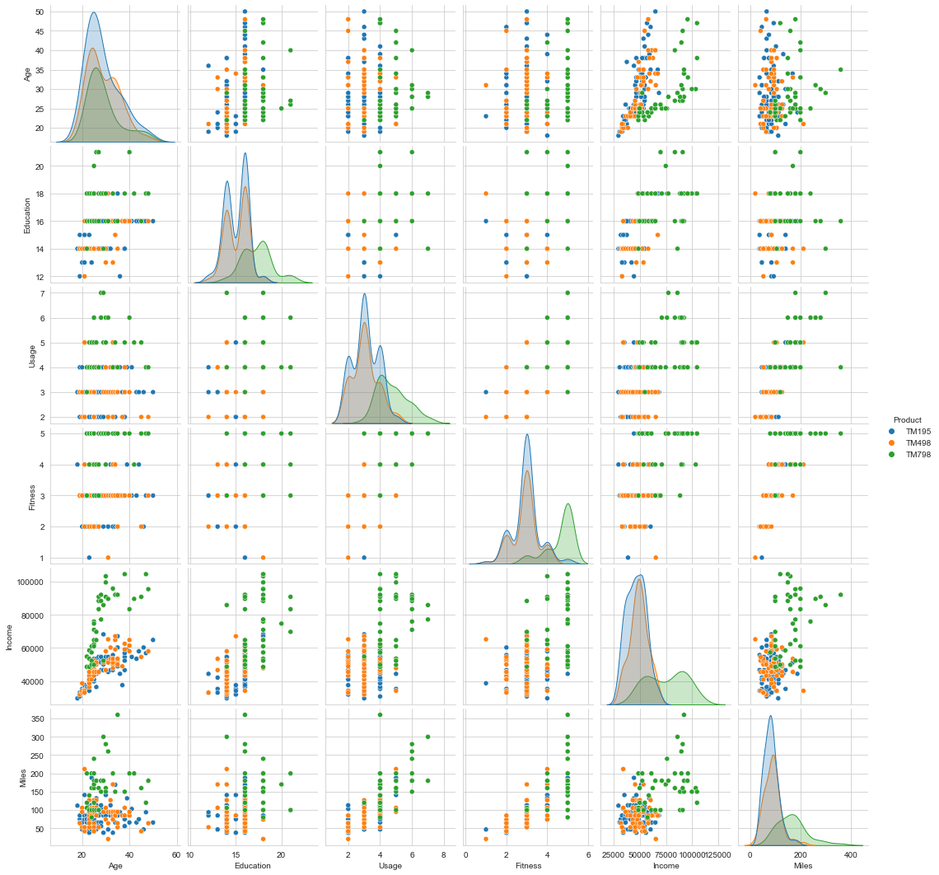
Data Relationship
Across different variables charts have been plotted to understand the relationship and how the products fair among them.
Age & Income have direct relationship.
Key observation to note is both products TM195 (Blue) & TM498 (Orange) always exist together, again proving that they are very redundant.
TM798 (Green) is more spread across Higher income people and more miles.
This Photo by Unknown Author is licensed under CC BY-NC

Slide 9
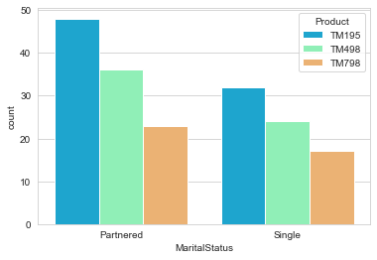
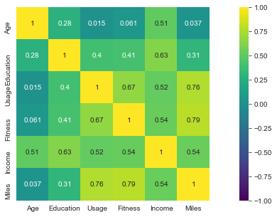
Correlation
Partnered people tend to buy more compared to single. It provides good insight as committed in relationship improves health awareness.
Heat map chart shows relationship between various numerical values. More +ve value shows higher correlation.
Age & Income are highly correlated. It is quite obvious
Age & Fitness (need to be fit) also highly correlated.
This Photo by Unknown Author is licensed under CC BY-NC

Slide 10
Business Insights and Recommendations
Based on the initial analysis of data, TM195 & TM498 looks to be more similar in terms of customer segmentation. Either cheaper product can be retired in lieu of the other one, just improving margins for Business.
TM798 is targeting very less group of people in the sample compared to other two, so slightly revising cost may be a better bet to increase sales.
There is a huge gap( 48K to 75K) in Income between TM195 group (TM498) & TM798, so introducing a product with slightly better features than lower group would open a new segment.
Lot of outlier data present in Age for TM798, so a separate analysis targeting on TM798 customers would provide more insight.
Regarding Data Collection, Occupation, Existing Health Condition would openup a new perspective data, since sedentary Occupation types would be a huge market.
Promotional campaigns for people owning TM195 to upgrade to TM498 may be an option.
Customer Segmentation for Products¶
TM195 -- Income Range 35K - 60 K, Partnered, Age between 25-35, Education of 15 Yrs.
TM498 -- Income Range 35K - 60 K, Partnered, Age between 25-35, Education of 15 Yrs.
TM798 -- Income Range 58K - 95K, Partnered/Single, Age above 25, Education above 15 yrs.

Slide 11

Questions
Questions give different Perspective, most of the time result in idea. No Questions means you didn’t understand
This Photo by Unknown Author is licensed under CC BY-NC

